Slide 1



Quality - Innovation - Vision
S-Curves & the Zero Bug Bounce:
Plotting Your Way to More Effective Test Management
    Presented By:
      Shaun Bradshaw
      Director of Quality Solutions
      Questcon Technologies
      November 9, 2006

Slide 2

Objectives
The primary objectives of this presentation are to instruct Test Leads & Managers on how to improve their ability to manage and track a test effort utilizing the S-Curve and Zero Bug Bounce, as well as communicate the results of a test effort to other members of the Project Team. To that end, the following concepts will be discussed:
  Test Management Using S-Curves
    What is an S-Curve
    Collecting Data
    Analyzing the Graph
  Defect Management with the Zero Bug Bounce
    Tracking Defects
    What is the Zero Bug Bounce
    Analyzing the Graph
Notes:
The Challenge
The use of objective test metrics is an important step toward improving your ability to effectively manage any test effort. This presentation discusses two significant test metrics concepts, the S-Curve and Zero Bug Bounce, which will allow Test Leads and Test Managers to track the progress of the test effort more easily, improve communication of test results and test needs to the Project Team, and make better decisions regarding when an application is ready for delivery.
The Approach
The primary objectives of this presentation are to instruct Test Leads on how to establish and use the S-Curve and Zero Bug Bounce graphs as tools for managing and communicating a software test effort. To that end, the following concepts will be taught as a part of this presentation:
Establishing an S-Curve – A brief tutorial on what an S-Curve is, why it is important in testing, how to develop a theoretical S-Curve, and what metrics can be tracked using the S-Curve and how to track them.
Establishing a Zero Bug Bounce – A brief tutorial on what the Zero Bug Bounce (ZBB) is, why it is important in tracking defects, and how to generate a ZBB.
Interpreting the Graphs – A method for examining and interpreting the graphs so you can make improvements to the current test effort as well as future development efforts.

Slide 3
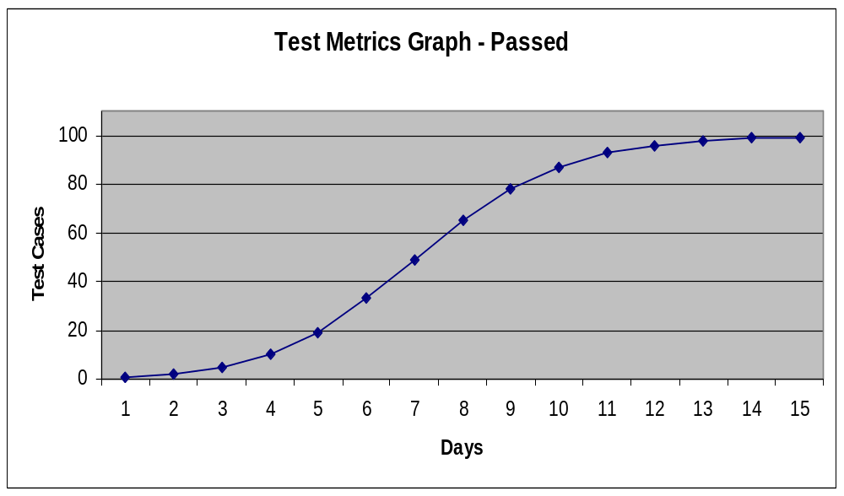
The S-Curve
The S-Curve

Slide 4
Test Management Using S-Curves
Successfully managing a test effort requires the ability to make objective and accurate estimates of the time and resources needed to stay on schedule. The S-Curve is one method for doing this.
What is an S-Curve?
What makes it
an “S” shape?
How is it used?

Slide 5

Test Management Using S-Curves
An S-Curve is a graphical representation of the cumulative work effort, or a subset of the work effort, of a software project.
  S-Curves can be used to describe projects as a whole, development efforts, and test efforts, as well as defect discovery rates.
  We will focus on how S-Curves are used to manage test execution and defect discovery rates.
What is an S-Curve?
What makes it
an “S” shape?
How is it used?

Slide 6
Test Management Using S-Curves
Test efforts typically start out slowly as test analysts run into a few major defects that prevent them from moving forward quickly
As the initial issues are resolved, the test analysts are able to execute more tests covering a larger variety of functionality
As the test effort nears its end, there are typically a few left over issues that must be resolved thus slowing the process down again
What is an S-Curve?
What makes it an “S” shape?
How is it used?

Slide 7
Test Management Using S-Curves
Plot the progress of various test metrics to quickly see the effectiveness of the test effort
  TCs Passed vs. Planned Execution Time
  Total Failures vs. Planned Execution Time
Measure test progress by comparing the actual test curve to a theoretical S-Curve
Use the curve to determine if the application is stable enough to be released
What is an S-Curve?
What makes it
an “S” shape?
How is it used?

Slide 8
The Theoretical S-Curve
The first step in utilizing an S-Curve for test management involves deriving a theoretical curve, that is, a uniformly distributed curve indicating “optimum” test progress.
  The theoretical S-curve is calculated as follows:
(Day Number / Total Days in Test Effort)
-------------------------------------------------------------------------------
(Day Number / Total Days in Test Effort) + e^(3-8 * Day Number / Total Days)
  Using this formula will return the cumulative percentage of tests passed or defects found (depending on the metric being tracked).
Note 1: “e” is the base of the natural logarithm (2.71828182845904)
Note 2: the “3” and “8” in the formula set the location of the logarithmic curves

Slide 9
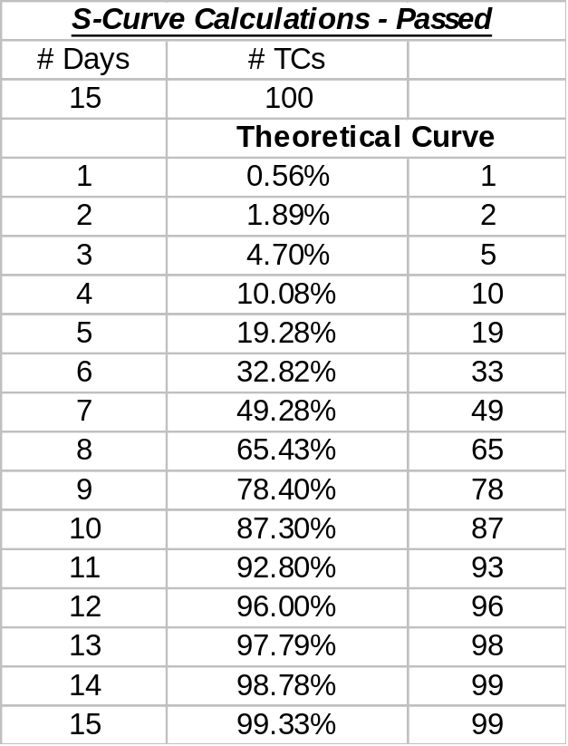
The Theoretical S-Curve
Here is an example of how a theoretical curve will look for a
15 day test effort with 100 test cases to be executed.

Slide 10
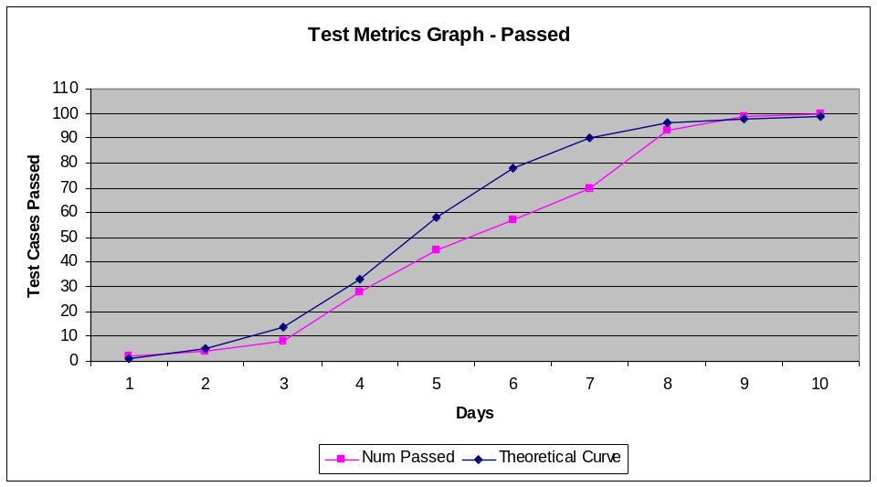
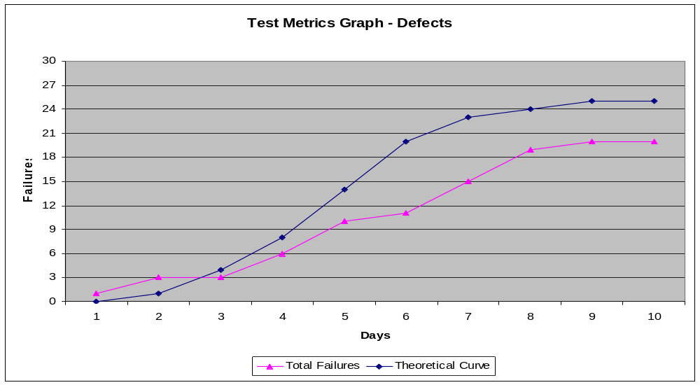
The Actual Test Curve
By plotting the actual cumulative number of test cases passed or the cumulative number of defects found during a test effort and comparing the resulting graph to the theoretical curve, we are able to quickly and objectively identify risks and/or issues in the test effort, which will be explained later.

Slide 11
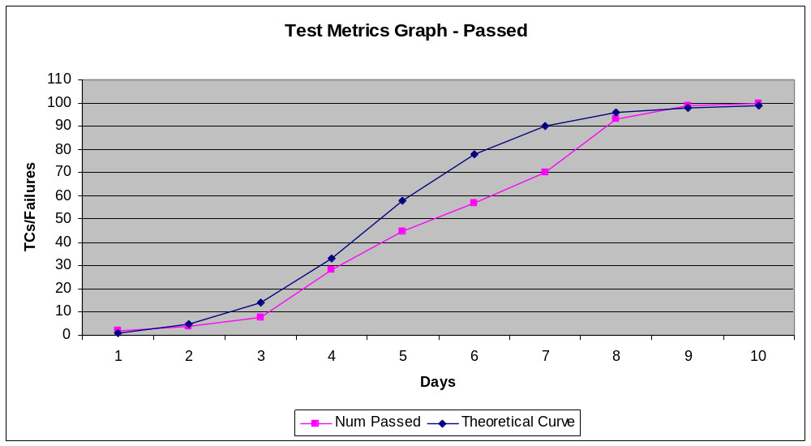
The Actual Test Curve
By plotting the actual cumulative number of test cases passed or the cumulative number of defects found during a test effort and comparing the resulting graph to the theoretical curve, we are able to quickly and objectively identify risks and/or issues in the test effort, which will be explained later.

Slide 12
The Actual Test Curve
By plotting the actual cumulative number of test cases passed or the cumulative number of defects found during a test effort and comparing the resulting graph to the theoretical curve, we are able to quickly and objectively identify risks and/or issues in the test effort, which will be explained later.

Slide 13
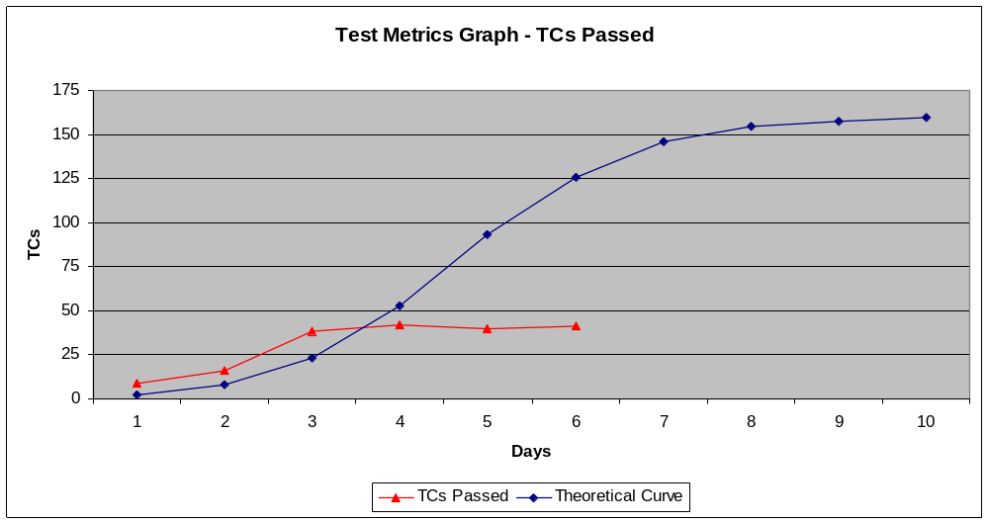
Analyzing S-Curves
What are some potential causes associated with this
S-Curve? How might you correct these issues?

Slide 14
Analyzing S-Curves
Potential Causes
Defects are causing significant numbers of test cases to be “blocked”
Test resource re-allocation during the test effort
Corrective Actions
Request an emergency fix from development team to correct the defect(s) causing tests to be blocked
Request additional test resources
Re-evaluate test case execution prioritization to ensure the most critical functionality can be tested prior to release

Slide 15
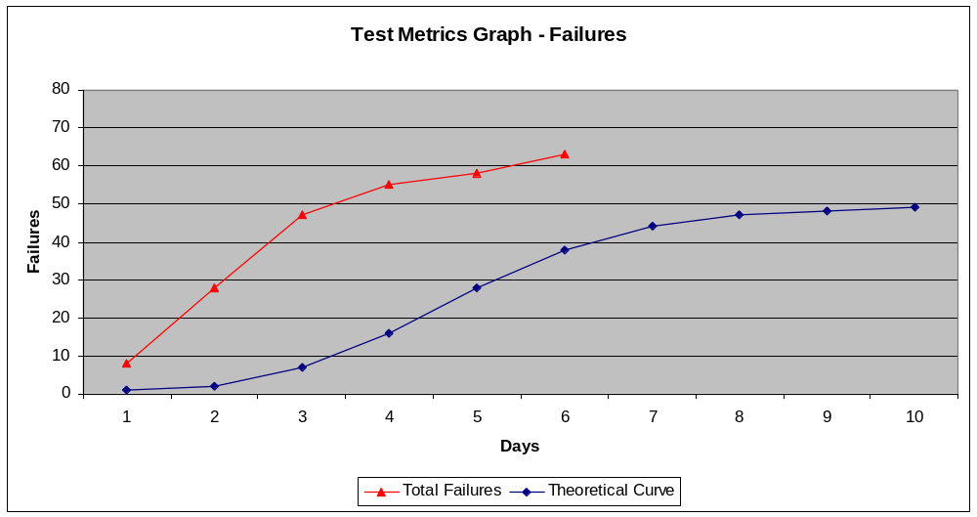
Analyzing the Graph
What are some potential causes associated with this
S-curve? How might you correct these issues?

Slide 16
Analyzing S-Curves
Potential Causes
Underestimated the number of defects in the release
Development team releases “bug fixes” with defects still present
Corrective Actions
Re-evaluate average defect rate related to this type of application or project
Request the Development Lead to enforce unit testing and/or peer-code reviews before releasing fixes to test

Slide 17
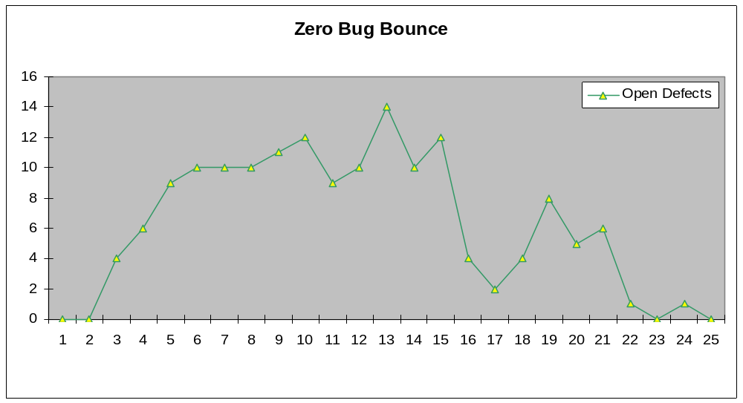
The Zero Bug Bounce
The Zero Bug Bounce

Slide 18
Tracking Defects
Defect tracking is the process of monitoring what happens to a defect when it is found during the test effort.
Without proper control over this process, it can be difficult to ensure that all of the objectives of the test effort have been met and to determine when it is complete.

Slide 19
Tracking Defects
Defect tracking allows us to evaluate our ability to adhere to the schedule based on the number of defects discovered and the amount of time to correct them.
Through this process we can track:
        Which defects must be fixed,
        When defects are corrected, and
        When the system is ready for production.

Slide 20
Defect Management with the Zero Bug Bounce
What is the Zero Bug Bounce?
The Zero Bug Bounce (ZBB) is a defect management technique made popular by Microsoft. Strictly speaking, it is the point in the test effort of a project when the developers have corrected ALL open defects and they have essentially “caught up” with the test team’s defect discovery rate. The “bounce” occurs when the test team finds additional defects and the development team must again begin defect correction activities.
After the initial bounce occurs, peaks in open defects will become noticeably smaller and should continue to decrease until the application is stable enough to release to production. This is what I call the ripple effect of the ZBB.

Slide 21
Defect Management with the Zero Bug Bounce
How do you track the ZBB?
The Zero Bug Bounce is tracked by charting the number of Open defects at the end of each day during test execution.

Slide 22
Defect Management with the Zero Bug Bounce
Some Notes On the ZBB
The “bounce” does not always happen at zero
The initial “bounce” typically occurs near the end of test execution
There IS a ripple effect
Use the height and length of the ripple effect, in addition to the timing of the initial bounce, to determine if the application is stable enough to be released to production

Slide 23
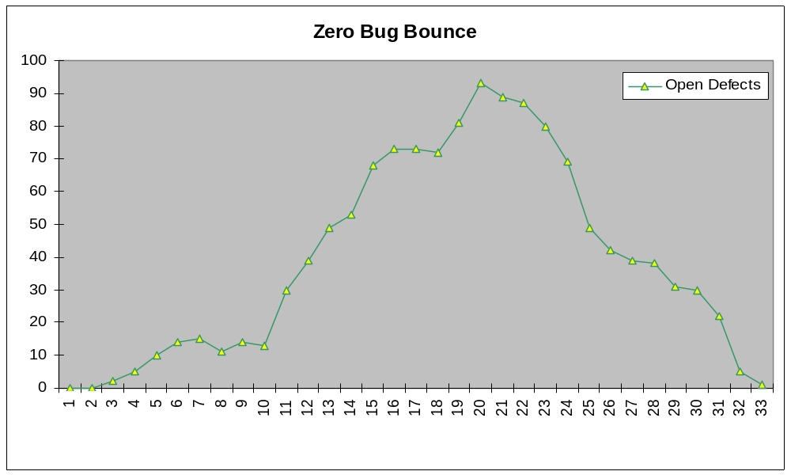
Analyzing the Graph
Question
Is the application under test stable enough to release into the production environment?
Answer
Possibly, but not likely. There is a significant chance that a ripple effect will occur.

Slide 24
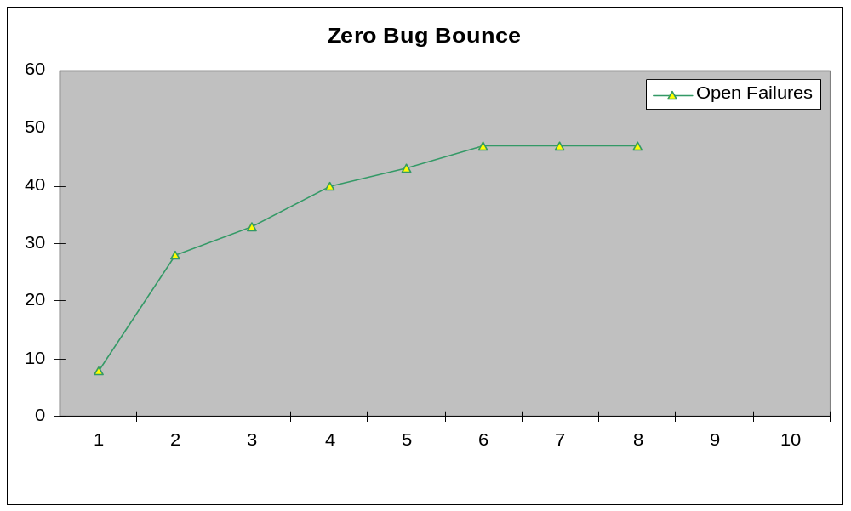
Analyzing the Graph
Question
What is wrong with this picture? Can the application be released in 2 days?
Answer
The developers are not correcting the defects in a timely manner. The application should not be released in 2 days.

Slide 25
Conclusion
The S-Curve and Zero Bug Bounce graphs can improve your ability to manage and track a test effort by providing visual clarity of the issues faced during test execution. Utilizing these graphs to measure and track test progress helps ensure timely and accurate delivery of a high-quality application to the production environment by:
  Helping to determine the resources necessary to complete the test effort in a timely manner
  Report the progress of the test effort through objective test metrics
  Assess the risk of component or application failure prior to release to production

Slide 26

Q & A

